Slide 1
‘Kerb the Flow’ Ollie Johnson
10th November 2021

Slide 2
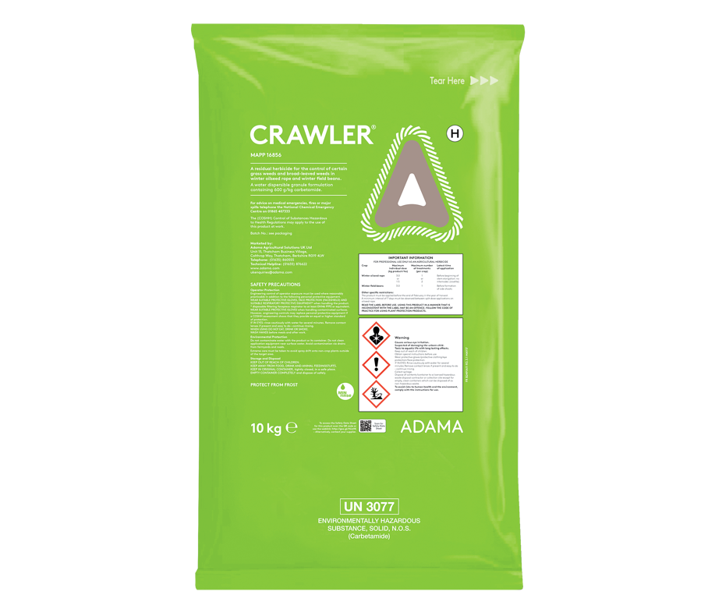
Carbetamide Revocation Confirmed
Final ‘sell by date’ 30th November 2021
Final ‘use by date’ 30th November 2022

Slide 3
Grassweed control beyond Carbetamide

Slide 4
Propyzamide Problem
September 2020 to April 2021 saw 185 detections of propyzamide above the drinking water standard of 0.1ug/l.
Of these, the highest was 17.39ug/l
Over the last 7 years, there have been no reductions in propyzamide in water

Slide 6
Questions?

Slide 7
Oliver Johnson
Key Account Agronomist
Voluntary Initiative IPM Champion
oliver.johnson@agrovista.co.uk

